Slide 1

SIGHT SENSE
Team Phoenix

Slide 2
What is the problem?
Visually impaired people have trouble recognizing objects
Risk of injuries

Slide 3
53.3%
30%
Between 1-5 times
More than 11 times
Distribution of frequencies of head-level accident experienced by people with visual impairment
(Period - 6 Months)
Source: Journal of visual impairment and blindness, 2021
Notes:
Journal of visual impairment and blindness 2021

Slide 4



Competitor’s solution
Apps using phone camera for object recognition
Vision
TapTapSee
Lookout by Google

Slide 5
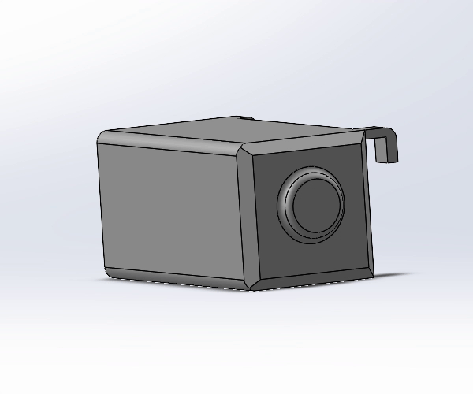
How are we different?
DETACHABLE CAMERA
01
02
EASY USAGE
03
ONE HAND FREE

Slide 6







How are we making this possible?
COCO SSD
TensorFlow.js
SpeechSynthesis
ESP32
React JS
C++
Firebase
Notes:
Tech stuff

Slide 7
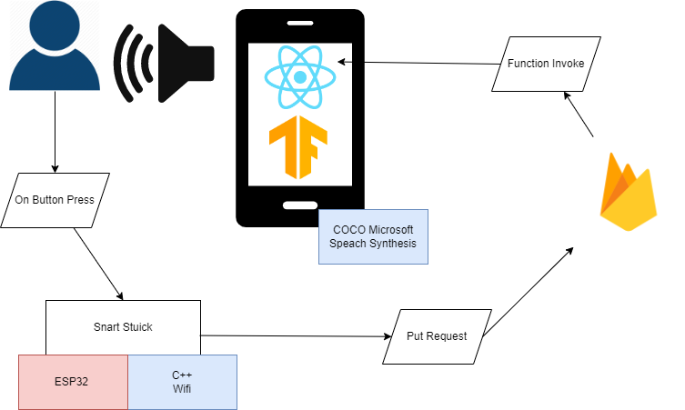
Prototype Demo Architecture
Smart Stick

Slide 8
Target persona
People with visual impairment
NGOs
Completely visually impaired
Partially visually impaired
European Blind Union
European Coalition for Vision

Slide 9
Cost of production
for 100 units
For the website - 5 000 BGN
For marketing - 1 500 BGN
Legal services - 200 BGN
Shipment - 500 BGN
Software - 8 000 BGN
Total : 18,200 BGN
Camera module - 100 x 7 BGN
Microprocessor - 100 x 5 BGN
Bluetooth module - 100 x 6 BGN
Speaker - 100 x 6.5 BGN
PCB - 100 x 5.5 BGN

Slide 10
How do we make money?
Profit margin
Subscriptions
Cost of production:
1 camera = 60 BGN
1 cane button = 7 BGN
100 sets = 6 700 BGN
Retail prices:
1 camera and cane button set = 80 / 85 BGN
So our profits:
From 1 set of camera and button = 13 / 18 BGN
From 100 sets = 1 300 / 1 800 BGN

Slide 11
Road Map
1
3
PRODUCTION
BREAK EVEN
2 Months
1 400 / 1020 sets
2
4
TEST PERIOD
FUTURE FEATURES
6 Month - 100 products
April 2023

Slide 12
Some features in the future
NAVIGATION
MORE DESCRIPTION
01
02
03
TEXT, COLOR RECOGNITION

Slide 13
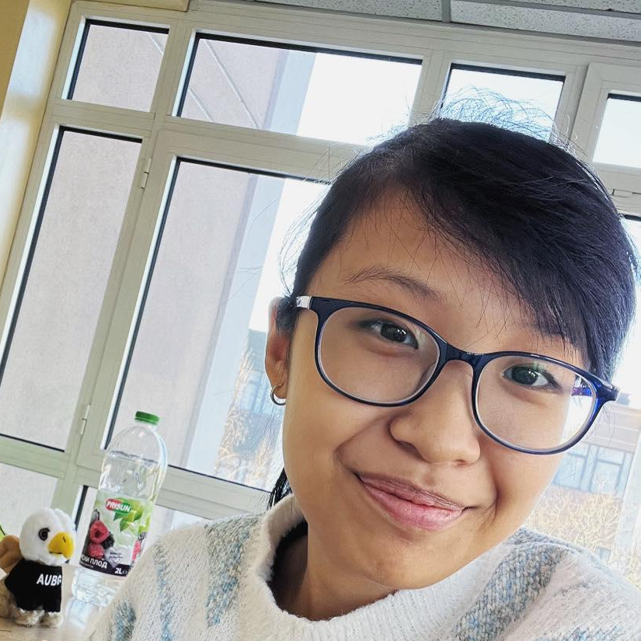
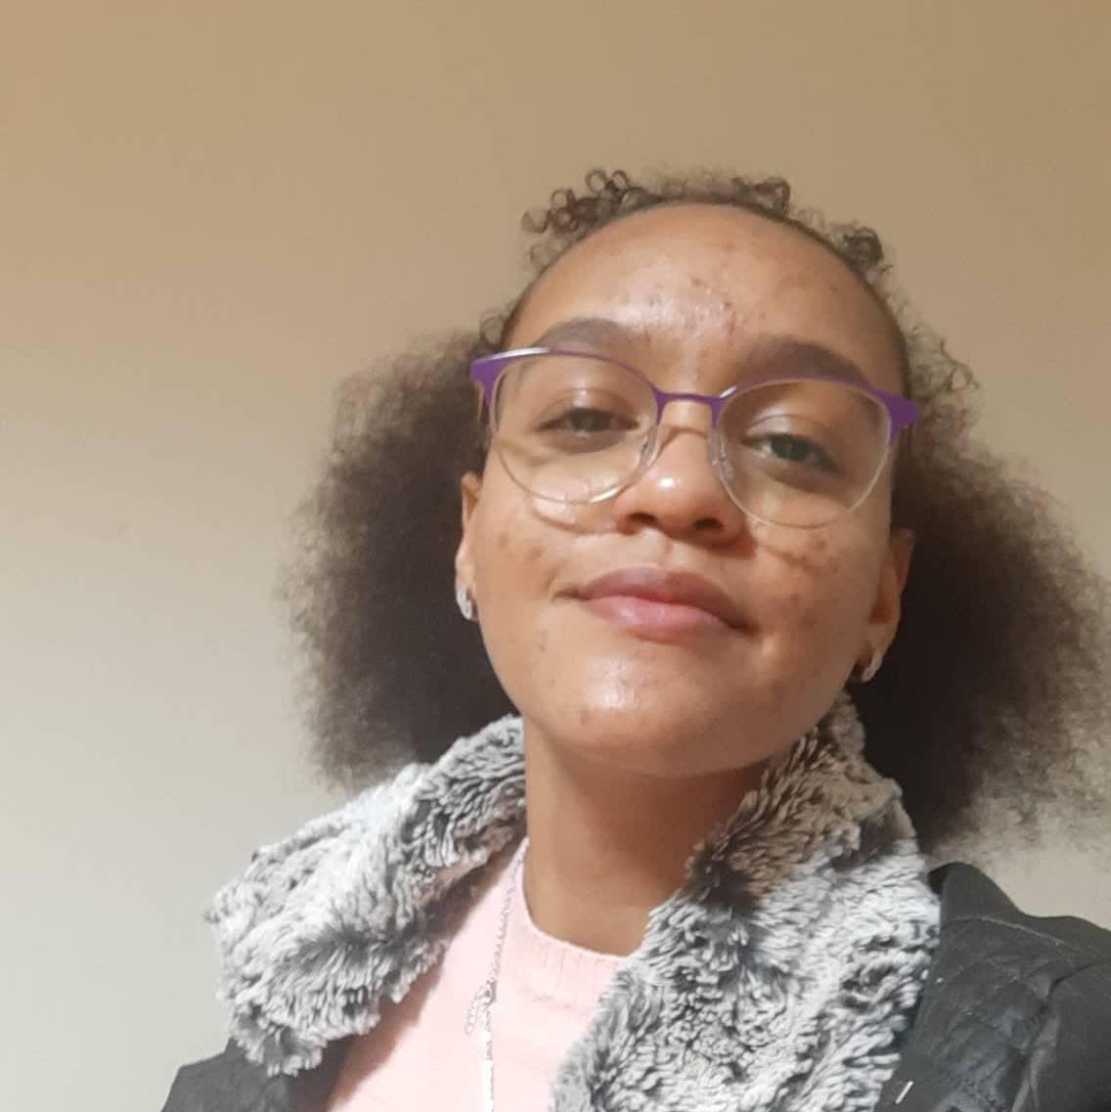

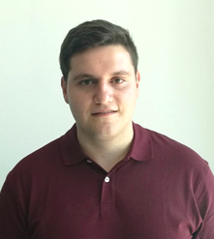

Who are we?
Duyen Le
Claire Apovo
Elena Ivanova
Martin Ayvazov
Nikola Slavov

Slide 14
Thank you for the attention!

Slide 15
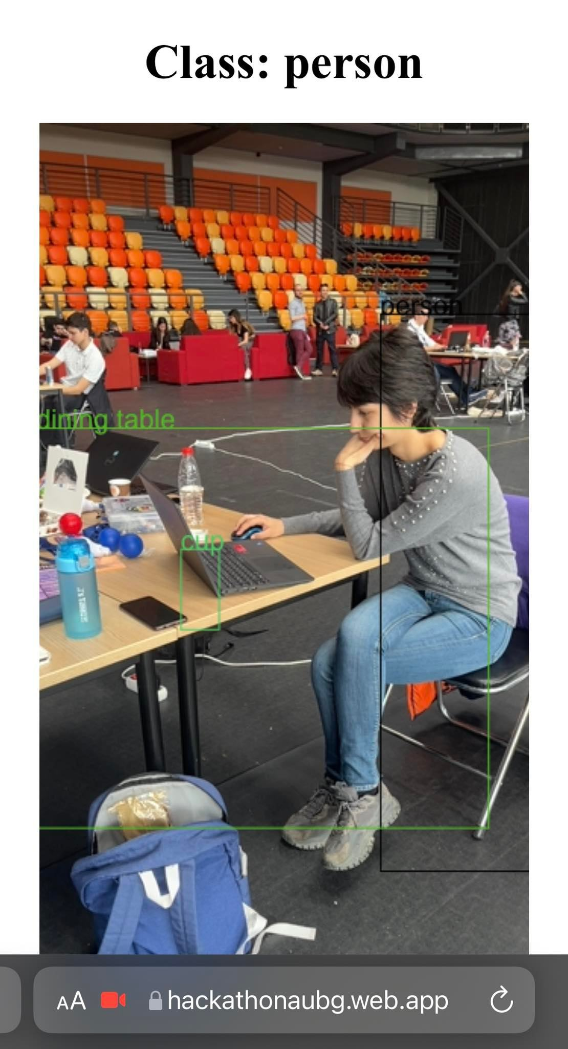

Slide 16
